Slide 1


NEURO FUZZY CLASSIFICATION
FOR DATA MINING TASKS
7th Semester Minor Project Report
Project Supervisor: Submitted By:
Prof. Himansu Das Shalini Jaiswal (1505062)
(KIIT University) Priyanka Mahato (1505049)
(B.Tech (CSE))

Slide 2

Introduction
Neuro-Fuzzy Systems which are a combination of soft computing and machine learning techniques are used in disease diagnoses like brain disorder, cardiac disease, breast cancer, alzheimer, thyroid disorder, leukemia, hypertension.It is also extensively used in medical image classification and recognition.
The final model we have proposed in our project is the neuro fuzzy system with feature reduction technique called PCA(Principal Component Analysis).This model performed better in comparision to the Artificial Neural Network,Fuzzy Neural Network and Artifical Neural Network with PCA.

Slide 3
Models Used
ANN FNN ANN with PCA FNN with PCA
Datasets Used for the Data Mining Task in which one is iris data set and three disease classification datasets:
Iris Dataset
Breast Cancer Wisconson Dataset
Pima Indian Diabetes Dataset
Mammographic Dataset

Slide 4

Literature Survey
According to the works of Jack V.Tu , Neural Networks provide better statistical modelling than logistic regression, less formal statistical training, implicitly detect complex nonlinear relationships between dependent and independent variables.
The disadvantages of neural network were also stated in his paper which included need of a large large dataset, “black box” nature, greater computational burden, proneness to overfitting.
According to Pal, S. K., & Ghosh, A the main advantages of FNN are (1) the ability to learn from experience, (2) a high computation rate, (3) the easily understandable manner in which knowledge acquired is expressed and (4) a high degree of robustness and fault tolerance.
According to the works of Hervé Abdi the goal of PCA is to extract the important information from the data table and to express this information as a set of new orthogonal variables called principal components.So it removes the unwanted data which reduces the analysis time.

Slide 5
Artificial Neural Network :
An artificial neural network is data processing methodology whose basic building block is a neuron whose name/property /behaviour is adopted from the neurons in the human brain.
Feed Forward Propagation of Information
h1
X1
h2
y
X2
h3
Output Layer
X3
h4
Input Layer
Hidden Layer
Back propagation of error
Figure : The Artificial Neural Network

Slide 6
Transfer Function :
Activation Function :
Working Principles
Assign Weights to the linkages between the input layer and the hidden layer.
Use the input nodes and linkages to find the activation rates of the hidden layer after which the activation of the output nodes can be found. This entire process is called feed-forward in Neural Network.
The error rate at the output node is found and thus the values of the hidden layer nodes ,output nodes and linkages are adjusted to reduce the output error rate.This is called Backpropagation.
The process of feed-forward and backpropagation are repeated till the required criteria is met and the error is minimised.

Slide 7
Working of Artificial Neural Network

Slide 8
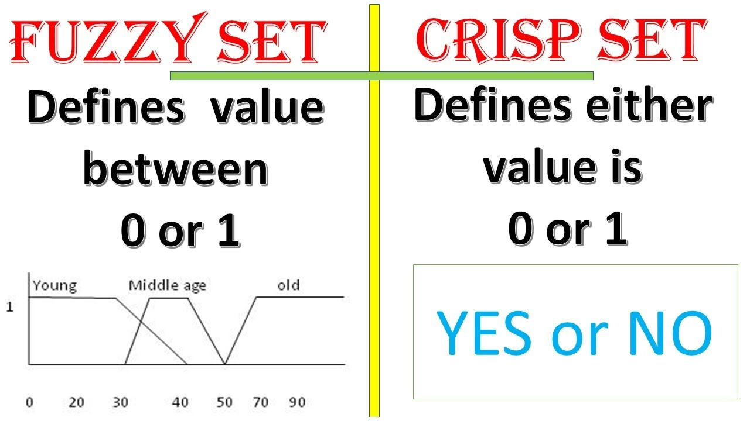
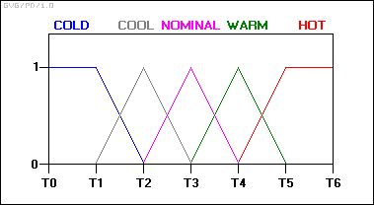
Fuzzy Logic:
Fuzzy logic is a form of many valued logic.
Fuzzy logic has rapidly become one of the most successful of today's technologies for developing sophisticated control systems.
Fuzzy logic addresses such applications perfectly as it resembles human decision making with an ability to generate precise solutions from certain or approximate information.

Slide 9
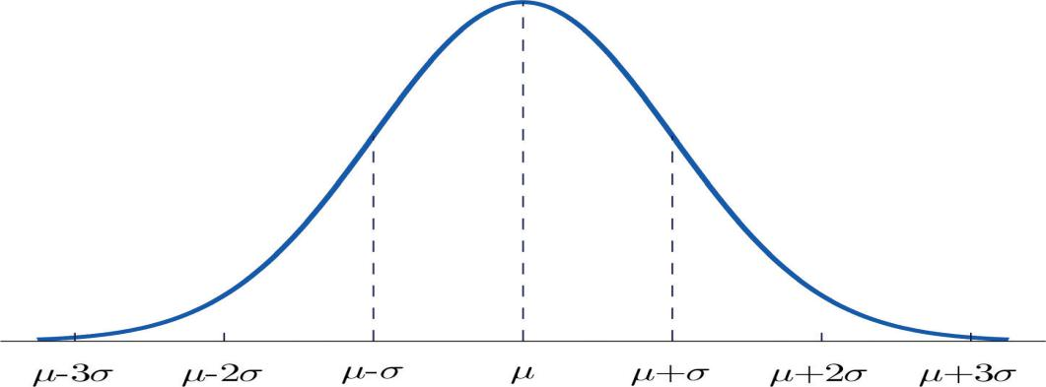
Bell Membership Function :
1
0.5
a p r q b
p = mean(n) - [max(n)-min(n)]/2
q = mean(n) + [max(n)-min(n)]/2
r = (p+q)/2
N=2
Figure : Bell MF

Slide 10
Neuro-Fuzzy Systems
Neuro-Fuzzy systems are a hybrid between Neural Networks and fuzzy logic in which the capability of fuzzy systems to adapt to problems in a way humans perceive and the fast learning ability of neural networks is utilized.
The tasks for which FNN are commonly used are:
1)Automation and Control System Design
2)Pattern recognition,classification and image processing
3)Modelling and Forecasting:It is used in time series analysis,stock market index prediction,exchange rate prediction
4)FNN are also used in being used for various typical disease diagnoses like brain disorder, cardiac disease, breast cancer,alzheimer, thyroid disorder, leukemia, hypotension, heart disease etc.

Slide 11
Dataset
Preprocessed
Data
Training
Preprocessing
Fuzzification
Neural Network
Testing
Performance Matrix
Figure : Block Diagram for Fuzzy Neural Network

Slide 12
mf1,1(Xi1)
mf1,2(Xi1)
.
.
.
mf1,m(Xi1)
.
.
mfn,2(Xi1)
mfn,2(Xi1)
.
w1
Σ
Xi1
Xi2
.
.
.
.
.
.
.
.
.
.
.
Xin
Σ
Σ
Output
w2
+
-
Input Columns
Σ
Membership Values
Hidden Layer
e
Figure : Step by Step Detail for implementation of Fuzzy Neural Network
Back Propagation

Slide 13
Principal Component Analysis (PCA):
PCA is a method of feature extraction which analyses the attributes and drops the least important attributes to use the most valuable attributes of the dataset without loosing the any information about the dataset .
PCA mainly used for dimensionality reduction in a model which reduces the noise and redundancy and increases the accuracy of the model.
Figure : Principal Component Analysis

Slide 14
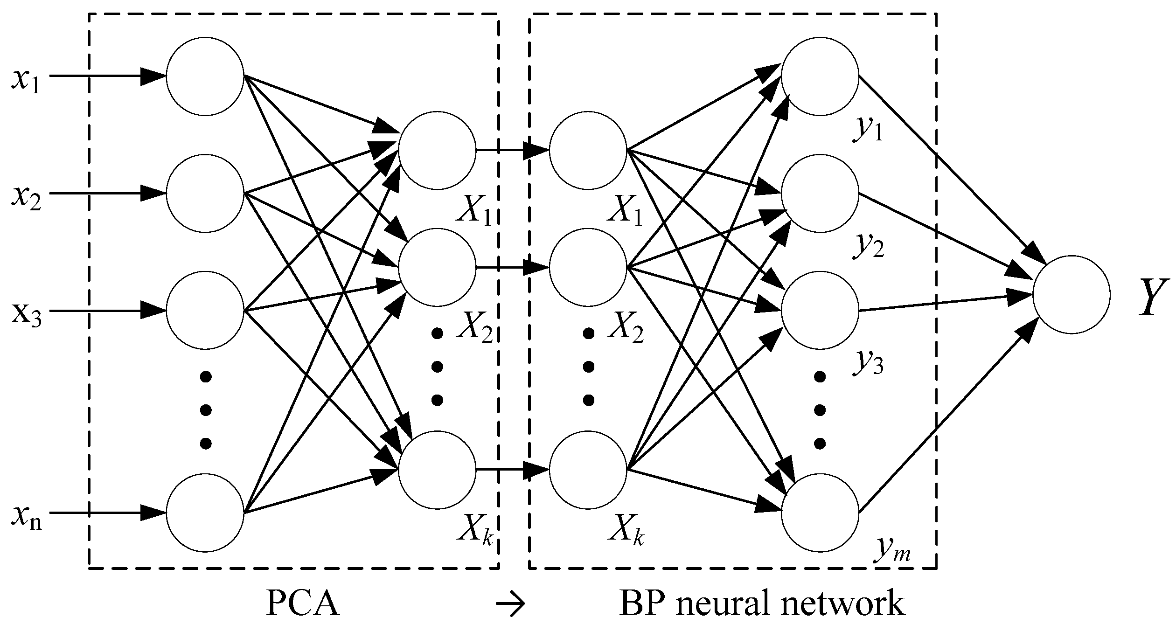
Model 3 - Artificial Neural Network with PCA :
PCA technique of feature reduction is used to reduce the number of input features given to the Artificial Neural Networks to include only those input features which have a maximum impact on the predicted output.
Figure : Artificial Neural Network With PCA

Slide 15
Model 4 - Fuzzy Neural Networks with PCA
The dimension of input features increases when the inputs are converted into their corresponding membership values.
Reduction of dimension of membership values is very important for fast and accurate computation of results.
The membership values that have low belonging to the output class have not been considered for result computation.

Slide 16
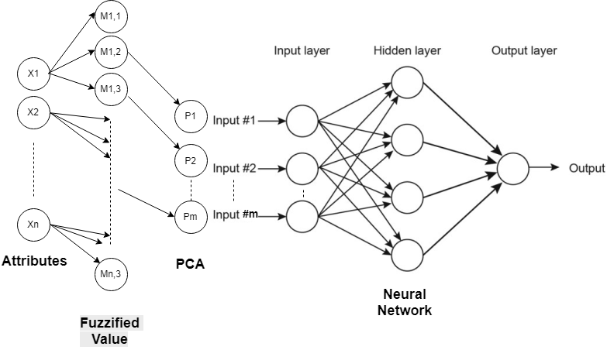
Figure: Block Diagram for FNN with PCA

Slide 17
Information about dataset :
Name | Total rows | TotalColumns | No. of classes | No. of rows in 1st class | No. of rows in 2nd class | No. of rows in 3rd class
Iris | 150 | 4 | 3 | 50 | 50 | 50
Mammographic Mass | 830 | 5 | 2 | 403 | 427 | -
Breast Cancer Wisconsin | 699(683) | 9 | 2 | 444 | 239 | -
Pima Indian Diabetes | 768 | 8 | 2 | 268 | 500 | -

Slide 18
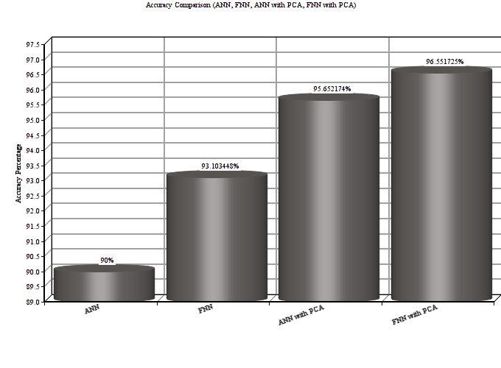
Result and Analysis
Iris Dataset
Fuzzy Neural Network with PCA had an accuracy of 96.5517% which is highest among all the implemented
models (ANN give’s accuracy of 90.0% , FNN give’s accuracy of 93.1034% and ANN
with PCA give’s accuracy of 95.652%) .It was also found most efficient in terms of
execution time too.

Slide 19
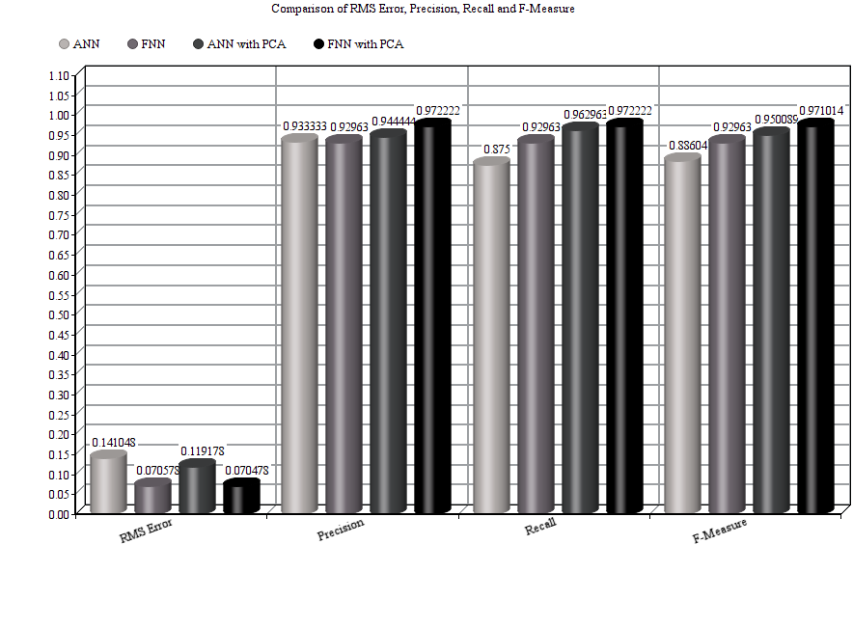
 | RMS Error | Precision | Recall | F-Measure
ANN | 0.14105 | 0.93333 | 0.875 | 0.88604
FNN | 0.07057 | 0.9296 | 0.9296 | 0.9296
ANN with PCA | 0.11907 | 0.9444 | 0.9629 | 0.9500
FNN with PCA | 0.0704 | 0.97223 | 0.9722 | 0.9710
Table : Performance measures of Iris dataset for different model
Fig : Co of Iris dataset for different model

Slide 20
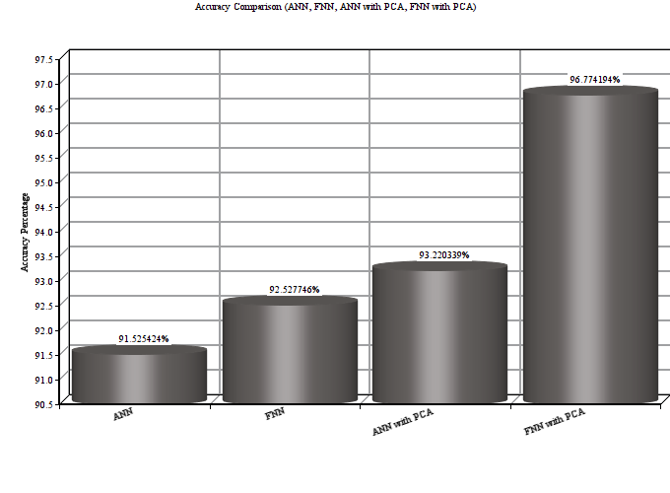
Breast Cancer Wisconsin Dataset:
Fuzzy Neural Network with PCA had a accuraccy of 96.774% which is highest among all the implemented models (ANN give’s accuracy of 91.525% , FNN give’s accuracy of 92.5277% and ANN with PCA give’s accuracy of 93.22%)

Slide 21
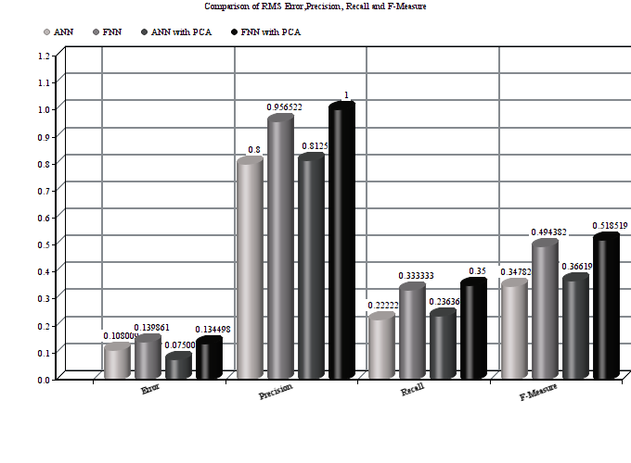
 | RMS Error | Precision | Recall | F-Measure
ANN | 0.10801 | 0.8 | 0.222 | 0.3478
FNN | 0.1398 | 0.957 | 0.333 | 0.494
ANN with PCA | 0.08313 | 0.8125 | 0.2364 | 0.3662
FNN with PCA | 0.13449 | 1.0 | 0.35 | 0.5185
Table : Performance measures of Breast Cancer Wisconson dataset for different model

Slide 22
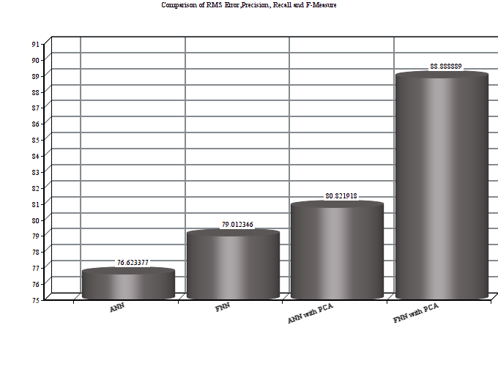
Pima Indian Diabetic Dataset
Fuzzy Neural Network with PCA had accuracy of 88.88% is highest among all the implemented models (ANN give’s accuracy of 76.623% , FNN give’s accuracy of 79.012% and ANN with PCA give’s accuracy of 80.82%) .It was most efficient in terms of execution time too.

Slide 23
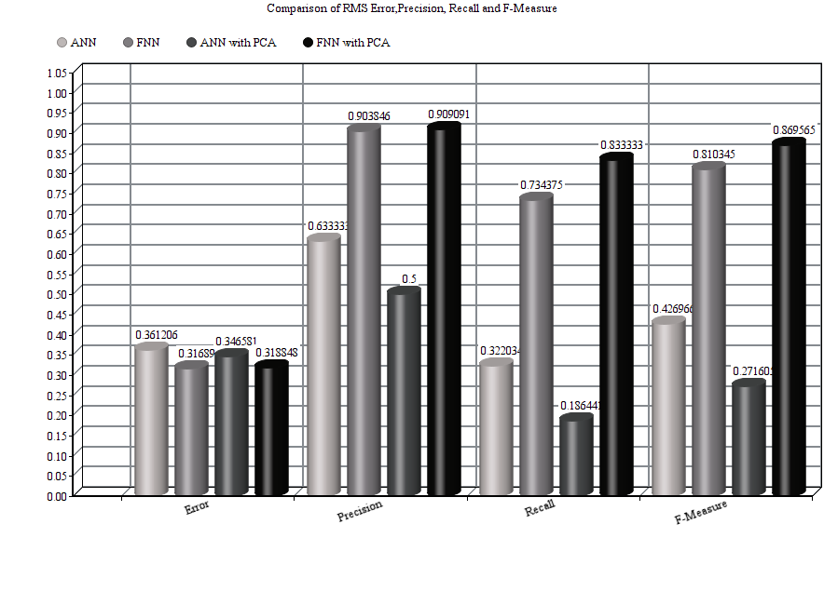
 | RMS Error | Precision | Recall | F-Measure
ANN | 0.3612 | 0.6333 | 0.32203 | 0.4269
FNN | 0.3168 | 0.9038 | 0.7343 | 0.8103
ANN with PCA | 0.3465 | 0.5 | 0.1864 | 0.2716
FNN with PCA | 0.3188 | 0.9090 | 0.8333 | 0.8695
Table: Performance measures of Pima Indian Diabetic dataset for different models

Slide 24
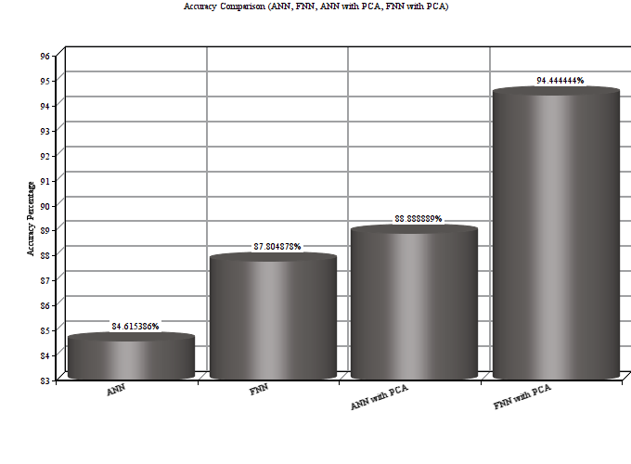
Mammographic Mass Dataset
Fuzzy Neural Network with PCA gave accuracy of 94.444% which is highest among all the implemented models (ANN give’s accuracy of 84.61% , FNN give’s accuracy of 87.80% and ANN with PCA give’s accuracy of 88.88%) and also found most efficient in terms of execution time too.

Slide 25
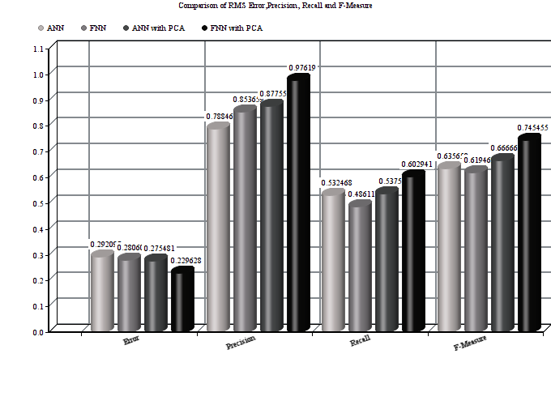
 | RMS Error | Precision | Recall | F-Measure
ANN | 0.2920 | 0.7884 | 0.5324 | 0.6356
FNN | 0.2806 | 0.8536 | 0.4861 | 0.6194
ANN with PCA | 0.2754 | 0.8775 | 0.5375 | 0.6666
FNN with PCA | 0.2296 | 0.9761 | 0.6029 | 0.7454
Table 2: Performance measures of Mammographic Mass dataset for different models

Slide 26
Extended Work - 7th Semester

Slide 27
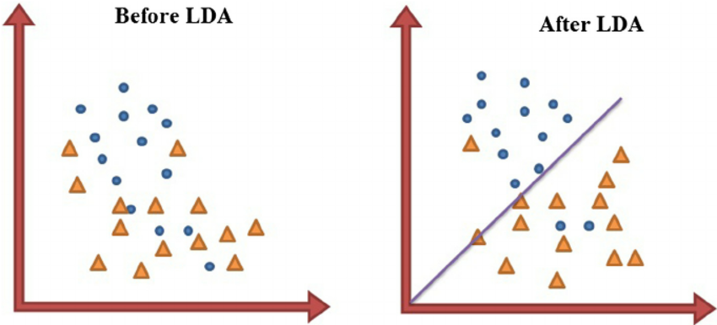
Introduction
Linear Discriminant Analysis(LDA) is a very common technique used for supervised classification problems.
LDA is a dimensionality reduction technique used as a preprocessing step in Machine Learning and pattern classification applications.
The main goal of dimensionality reduction techinques is to reduce the dimensions by removing the reduntant and dependent features by transforming the features from higher dimensional space to a space with lower dimensions.

Slide 28
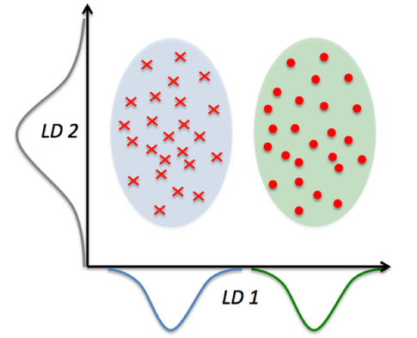
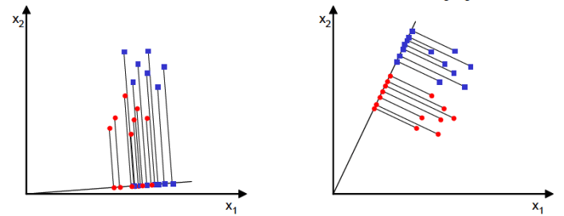
This can be achieved in three steps :
The first step is to calculate the separability between different classes(i.e the distance between the mean of different classes) also called as between-class variance
Second Step is to calculate the distance between the mean and sample of each class,which is called the within class variance
The third step is to construct the lower dimensional space which maximizes the between class variance and minimizes the within class variance.

Slide 29
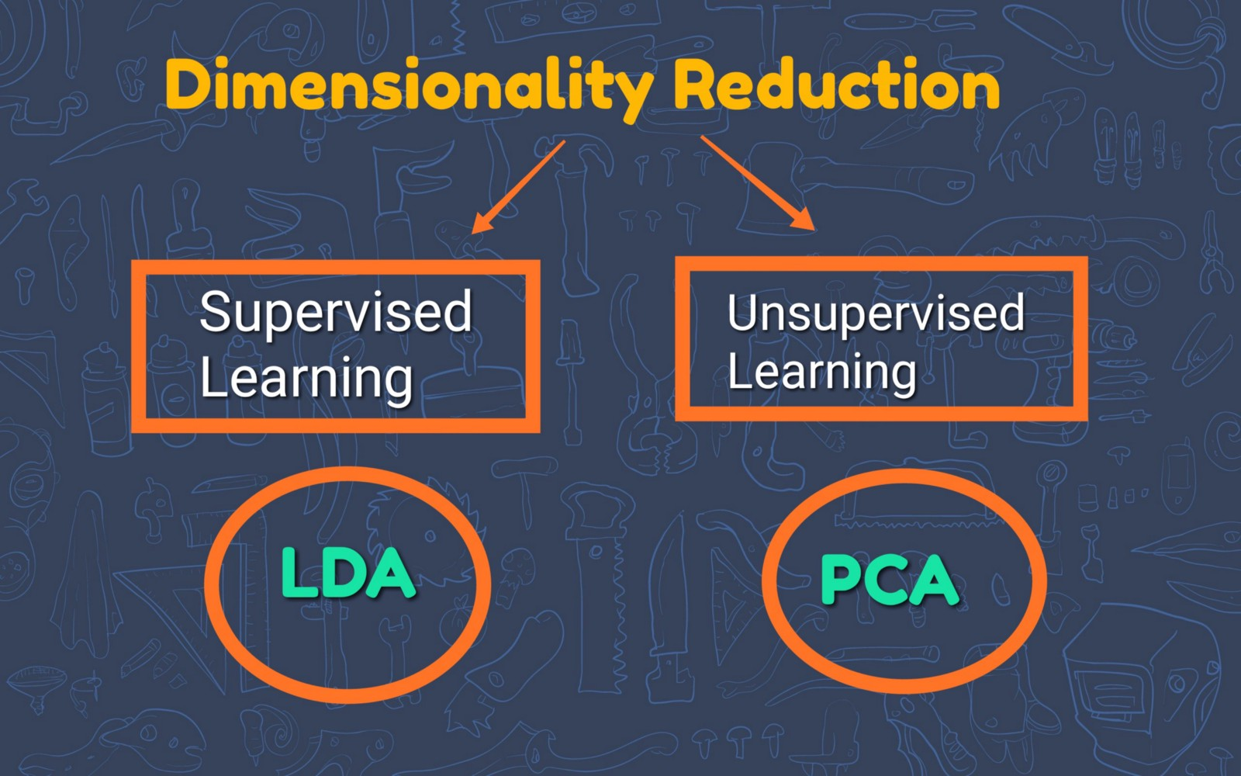
Difference between LDA and PCA
The goal of LDA is to find the feature subspace that optimizes class separability (see figure below). Hence LDA is a supervised algorithm.
PCA is an unsupervised algorithm that is used for feature extraction in high-dimensional and correlated data. PCA achieves dimensionality reduction by transforming features into orthogonal component axes of maximum variance in a dataset.

Slide 30
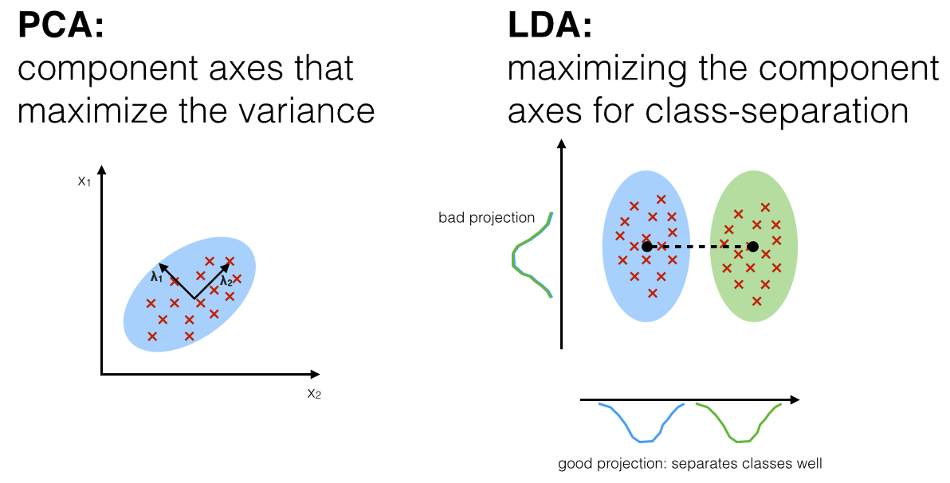

Slide 31
Application and Area of use
Linear Discriminant Analysis is applied in positioning and product management. Other applications are the following:
Bankruptcy prediction
In bankruptcy prediction based on accounting ratios and other financial variables, linear discriminant analysis was the first statistical method applied to systematically explain which firms entered bankruptcy vs. survived.
Face recognition
In computerized face recognition, each face is represented by a large number of pixel values. Linear discriminant analysis is primarily used here to reduce the number of features to a more manageable number before classification.
Marketing
In marketing, discriminant analysis was once often used to determine the factors which distinguish different types of customers and/or products on the basis of surveys or other forms of collected data. .
Biomedical studies
The main application of discriminant analysis in medicine is the assessment of severity state of a patient and prognosis of disease outcome.

Slide 32
Result Analysis
To check the performance of linear discriminant analysis we have used 13 datasets which are as follows: 1.Iris 2. Breast Cancer 3. Thyroid 4. Haberman 5. Hayes roth 6. Wine 7. Titanic 8.Pima 9.Mammographic 10..Blood Transfusion Dataset which performed according to assumption are 1.Iris 2. Breast Cancer 3. Thyroid 4. Haberman 5. Hayes roth 6. Wine 7. Titanic The datasets which did not perform acc to the assumption are 1.Pima 2.Mammographic 3.Blood Transfusion

Slide 33
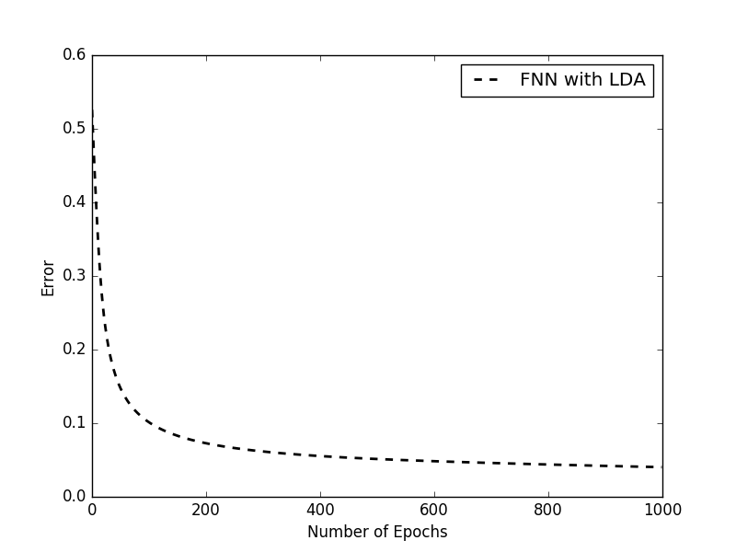
Result Table
Error plot
Breast-Cancer Wisconsin Dataset
Accuracy | RMS ERROR | Precision | Recall | F-Measure | Time
96.36% | 0.078 | 0.98 | 0.41 | 0.569 | 14.018
97.90% | 0.088 | 0.951 | 0.278 | 0.43 | 14.65
97.67% | 0.077 | 0.951 | 0.314 | 0.472 | 14.16
97.52% | 0.065 | 0.93 | 0.353 | 0.449 | 14.09
96.72% | 0.081 | 0.97 | 0.39 | 0.534 | 14.002
97.02% | 0.072 | 0.98 | 0.327 | 0.439 | 14.15
96.89% | 0.082 | 0.94 | 0.34 | 0.442 | 14.4
97.17% | 0.075 | 0.96 | 0.44 | 0.39 | 14.05
96.14% | 0.071 | 0.389 | 0.48 | 0.42 | 13.45

Slide 34


